Slide 1

Unlocking Cinematic Success
A Strategic Analysis of successful Film Genres for Microsoft's Foray into the Movie Industry

Slide 2

Setting the Stage: Ensuring Microsoft's Successful Debut in the Movie Industry
While the film industry can yield a high profit margin it can also be a tough industry to understand and predict if you are new to this field.

Slide 3


Methods
The following insights are based on IMDb viewer rating scores as well as the production budgets & total profits.
Film reviews play a crucial role as they not only serve as a marketing tool for film production studios but also serve as indicators of a movie's potential financial performance by influencing consumer perspectives.
Box Office Gross vs Production costs is also a crucial focus point for a company starting out in this industry given the high upfront costs involved in movie production. It is important to know whether there will be a ROI.
To ensure this data yielded the most accurate results, it was first cleaned out of any empty values and also filtered to only include relevant information. For example, for the IMDB reviews, any movies with less than 500 reviews were removed from the data as they would not provide an accurate representation of the greater audience population.

Slide 4
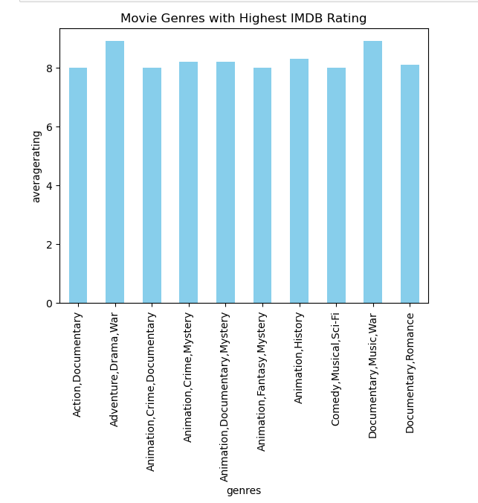
A Look at the Top Genres
The top 10 genres, including Action, Documentary, Animation, and more, all boast IMDb scores ranging from 8.0 to 8.9.*
Let's delve into the IMDb scores of our top 10 genres:
Action, Documentary - 8.0
Animation, Crime, Documentary - 8.0
Animation, Fantasy, Mystery - 8.0
Comedy, Musical, Sci-Fi - 8.0
Documentary, Romance - 8.1
Animation, Documentary, Mystery - 8.2
Animation, Crime, Mystery - 8.2
Animation, History - 8.3
Documentary, Music, War - 8.9
Adventure, Drama, War - 8.9
*Please note all movie scores used in this had minimum 500 reviews in order to have a more accurate picture of what the audience is interested in

Slide 5
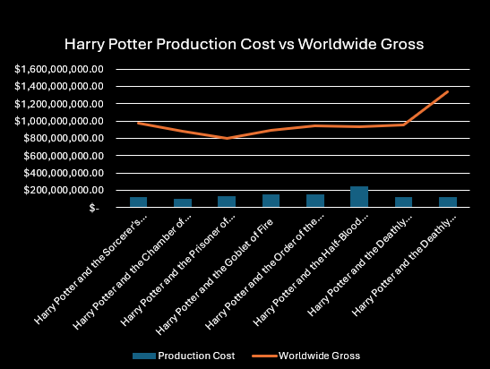
Acquiring Established Intellectual Properties
Acquiring rights to popular books, movie franchises, and older properties ripe for remakes can significantly mitigate risks and enhance return on investment. These properties come with a built-in fan base, providing a solid foundation for success at the box office.
Using the Harry Potter Franchise as an example we can see that the production costs stayed relatively the same across the eight-movie franchise, however every movie was extremely successful at the box office.
The final film had the same production budget as the first film but had a profit margin of 89%

Slide 6
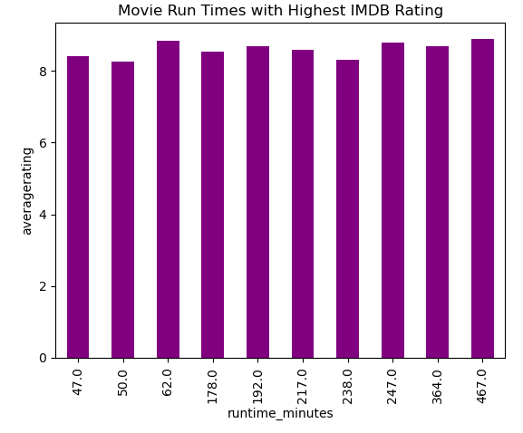
Movie Run Time in relation to reviews
Given the upfront costs involved in Producing a movie, from casting, filming and through to editing. It seemed worthwhile to see if there was any correlation between high reviews and the movie run time.
It is clear that runtime is not a deciding factor in viewers overall critical opinions of the film

Slide 7
Results
When moving into a new industry it is important to focus on what is in your control and what is quantifiable. This is why the main focus of this data was the most popular movie genres.
Key Take Aways:
Genres such as Action, Documentary, and Animation consistently yield high IMDb scores.
Invest in established intellectual properties to drive high ROI and take out some of the risks involved in up front production costs.
Movie run time does not have a clear correlation between how well it is critically received

Slide 8
Thank you
Email: karinagillian@gmail.com
GitHub: @karinagillian
LinkedIn: www.linkedin.com/in/karina-gillian-smith

